Slide 1
Project Team #1 Coronary Artery Disease (CAD) Predictive Model
By: Danielle Kalkofen, Ph.D., Kaddi Pham,
LaShonda Coleman, and Peggy Blaine
July 12, 2019

Slide 2
Coronary Artery Disease Basics
Also known as CAD:
It is a narrowing or blockage of arteries that provide oxygen and nutrients to the heart. ⁽²⁾
It is an important health topic to study and understand because:
It’s the leading cause of death for both men and women in the United States. ⁽²⁾
More than 13 million Americans have active symptoms of CAD. ⁽²⁾
It is often also referred to as coronary heart disease (CHD) and heart disease, though technically, they are not quite the same thing.

Slide 3
Proposed CAD Indicators
Analysis:
Based on these 9 attributes that are indicators of heart disease, build a model: ⁽¹⁾
Age
Sex
Chest Pain (cp): typical angina or non-typical angina
Resting Blood Pressure (trestbps)
Serum Cholesterol (chol)
Fasting Blood Sugar (fbs): if > 120 mg/dl) (1 = true; 0 = false)
Resting Heart Rate (thalrest)
Exercise Induced Angina (exang): 1 = yes; 0 = no
Diagnosis of Heart Disease (num): based on angiographic disease status: < 50% diameter narrowing = 0; > 50% diameter narrowing = 1
Based on relevant and current literature, verify these attributes are major indicators of heart disease. ^{(2, 3)}
Train the model to predict: who will/will not develop heart disease

Slide 4
UCI Dataset Information
UCI Background Information
Datasets include 4 databases from 4 locations:
Cleveland: 282 records
Hungary: 294 records
Switzerland: 123 records
Long Beach: 200 records
Database Source Clinics and Creators:
Cleveland Clinic Foundation: Robert Detrano, M.D., Ph.D.
Hungarian Institute of Cardiology. Budapest: Andras Janosi, M.D.
Switzerland:
University Hospital, Zurich, Switzerland: William Steinbrunn, M.D.
University Hospital, Basel, Switzerland: Matthias Pfisterer, M.D.
V.A. Medical Center, Long Beach, CA: Robert Detrano, M.D., Ph.D.
Data Analyzed:
Original dataset: 920 records with 14 attributes
Cleaned dataset: 899 records with 9 attributes

Slide 5
NHANES Dataset Information
Datasets include records
Database Source Clinics and Creators:
, M.D., Ph.D.
Data Analyzed:
Original dataset: 10,000?? records with ?? attributes
Cleaned dataset: 646 records with 9 attributes

Slide 6
Dataset Assumptions
UCI Dataset:
records
NHANES Dataset:
rano, M.D., Ph.D.

Slide 7
Heart Disease Per UCI Datasets
 | Cleveland | Long Beach | Hungary | Switzerland
No | 157 | 51 | 187 | 8
Yes | 125 | 149 | 107 | 114

Slide 8
UCI vs NHANES CAD
 | UCI | NHANES
No | 403 | 550
Yes | 495 | 96

Slide 9
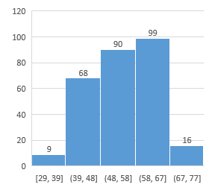
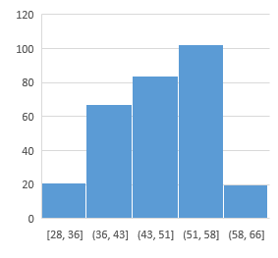
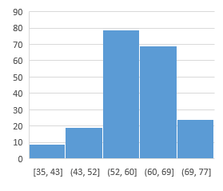
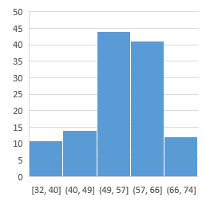
Age Distribution Per UCI Datasets
Cleveland | Long Beach | Hungary | Switzerland

Slide 10
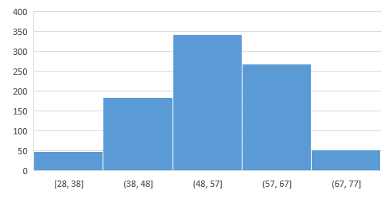
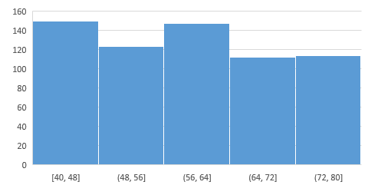
UCI vs NHANES Age Distribution
UCI | NHanes

Slide 11
CAD Predictive Model
Random Forest info here

Slide 12
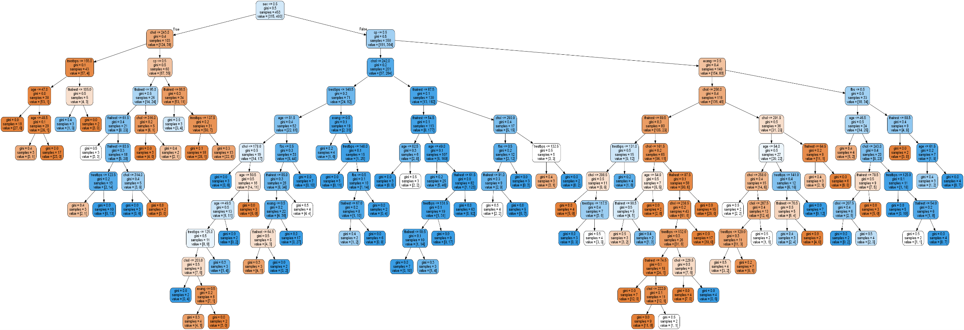
Example Tree from Random Forest
Tree #5

Slide 13
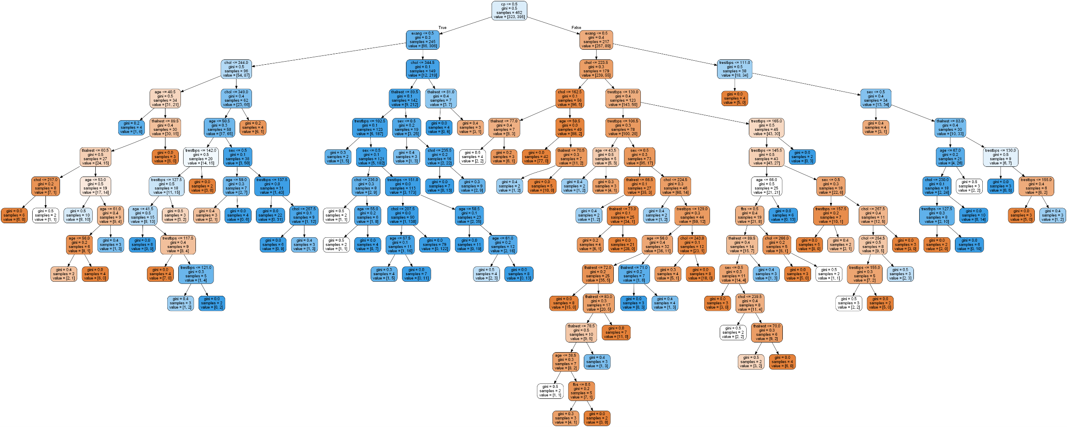
Example Tree from Random Forest
Tree #500

Slide 14
Results of Predictive Model
???Results:
80% of the UCI Dataset was used for “training”.
20% of the UCI Dataset was used for testing the “trained model”.
NHANES Dataset was used for running a second test on the “trained model” to confirm the results from both testing scenarios returned similar results.

Slide 15
Model Statistics
UCI Training Dataset | NHANES Dataset

Slide 16
Conclusion
Conclusion:
Describe how well we believe our model worked especially compared to another model.
Find other dataset(s) to test with
Determine if there are different parameters we would use for further tests
NHANES dataset did not have several measurements for the patients under 40 years old.
Differences in terminology should be removed

Slide 17
Further Study
Further Study
Use other years of the NHANES dataset
Find other dataset(s) to test with
Determine if there are different parameters we would use for further tests
NHANES dataset did not have several measurements for the patients under 40 years old.
Differences in terminology should be removed

Slide 18
Heart Disease Prediction Model
References:
Detrano, Robert, MD, PhD; Janosi, Andras, MD; Steinbrunn, Walter, MD; Pfisterer, Matthias, MD; Schmid, Johann-Jakob, DE; Sandhu, Sarbjit, MD; Guppy, Kern H, PhD; Lee, Stella, MS; Froelicher, Victor, MD. (1989, Aug). “International Application of a New Probability Algorithm for the Diagnosis of Coronary Artery Disease”. The American Journal of Cardiology, Volume 64, Issue 5, pp: 304-310.
Coronary Artery Disease. (n.d.) The Free Dictionary web site. Retrieved 7/11/2019 from https://medical-dictionary.thefreedictionary.com/coronary+artery+disease

